Slide 1
HTTP Triggers to manage Snowflake table data
Final Presentation – Data And Analytics Unit
By Gavin Aren
Mentor: Marella Anji Reddy
Notes:
Creating HTTP Triggers

Slide 2

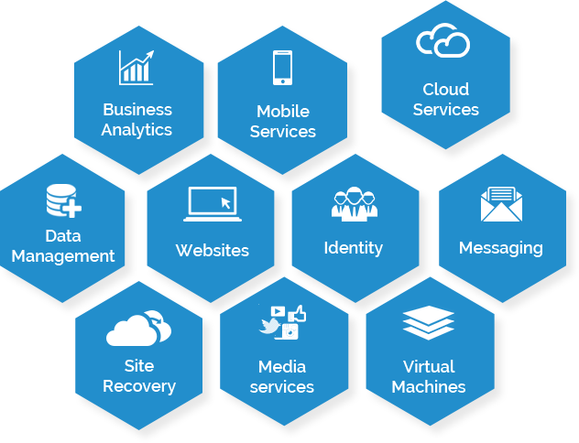
Microsoft Azure
A range of cloud services
Provides:
Compute
Analytics
Storage
Networking
Source: https://www.advoco-solutions.co.uk/it-services/microsoft-products/windows-azure/
Notes:
I will give you a quick overview of the 2 main platforms I have used. IT IS A CLOUD SERVICE PROVIDER. Their services facilitate _____ in the cloud. The main reason everyone’s moving to cloud is because Cloud services are Scalable, secure, cost-effective, configurable

Slide 3

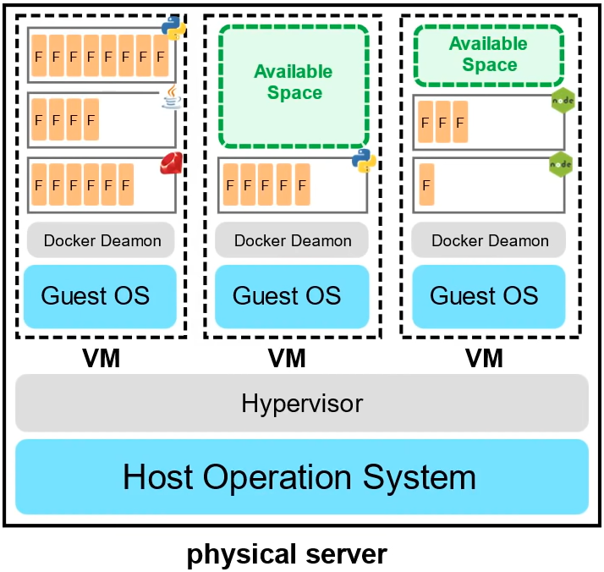
Azure Functions
A managed VM that is running managed containers
Known as Serverless Compute
Only responsible for the code and data, nothing else
Very cost-effective
Source: https://www.youtube.com/watch?v=NKEFWyqJ5XA
Notes:
We used to dedicated Servers in the cloud.
I upload my code to be hosted on the function and that’s it

Slide 4

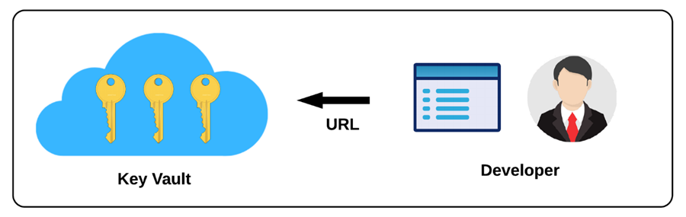
Azure KeyVault
A vault for securely storing and accessing secrets
Had tightly configurable access controls for these secrets
Secrets can be anything from passwords to certificates and cryptographic keys
Source: https://www.partech.nl/nl/publicaties/2020/08/azure-key-vault
Notes:
Key Vault provides a cloud based key management solution. Using this you can create and control keys used to encrypt data. You can then integrate other services with key vault and decrypt secrets without knowing the encryption keys.

Slide 5

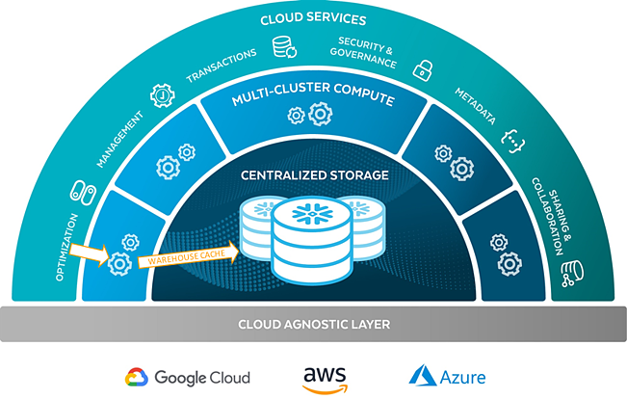
Snowflake
Cloud based data-warehousing company. Allows you to mobilise data with near unlimited scale, concurrency and great performance.
Separates storage from compute so customers can pay for storage and compute separately, and its cheap
Source: https://www.biztory.com/blog/what-are-the-different-snowflake-components
Notes:
Allows storage and compute to scale independently so customers can use and pay for storage and computation separately

Slide 6

Explanation of my project
I am creating HTTPS endpoints that trigger a function when given the right input parameters
Meaning, given the right input, the endpoint will trigger some Python code in the back-end, process this input.
I have been making 4 triggers, GET, POST, DELETE and UPDATE (PUT), each of which come with a unique URL to access them. These trigger the appropriate action (such as fetching, adding or deleting data) to a Snowflake table they are connected to.
Finally, to avoid putting the user’s credentials to access the Snowflake table in plaintext in the code, I stored and referenced these credentials using Azure KeyVault

Slide 7
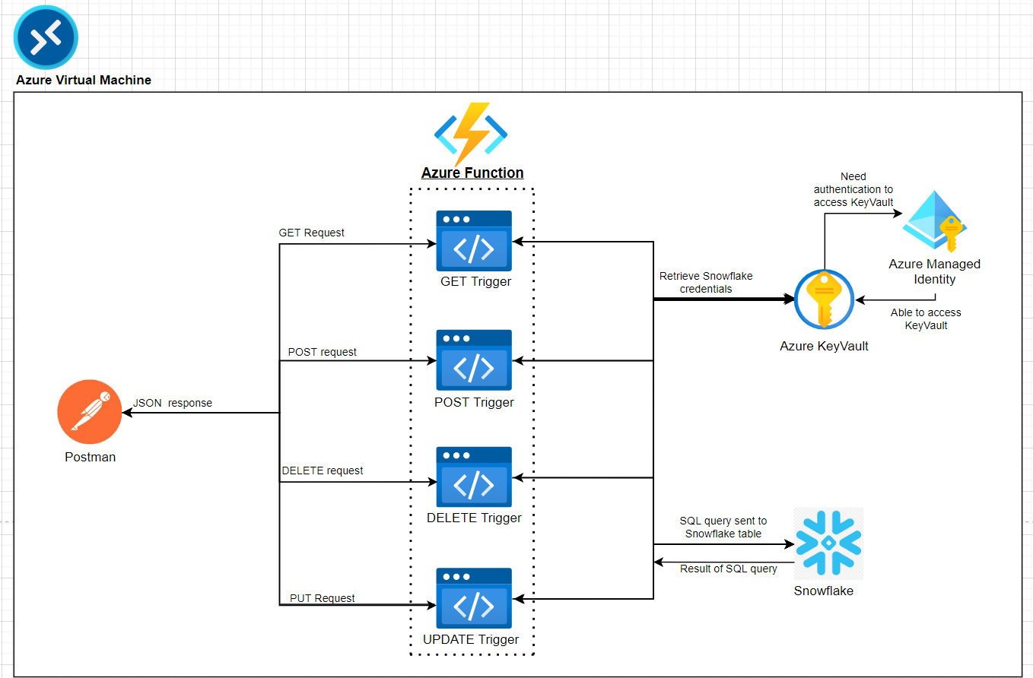
System Architecture Diagram
Notes:
My function tries to access the scerets in the kayvault but it doesn’t have access to it, so it needs authentication from the managed identity it is connected to.
Create a managed identity and grant it access to the KeyVault. Now connect the Azure function to the identity so it can access KeyVault

Slide 8
My Workflow Management System

Slide 9
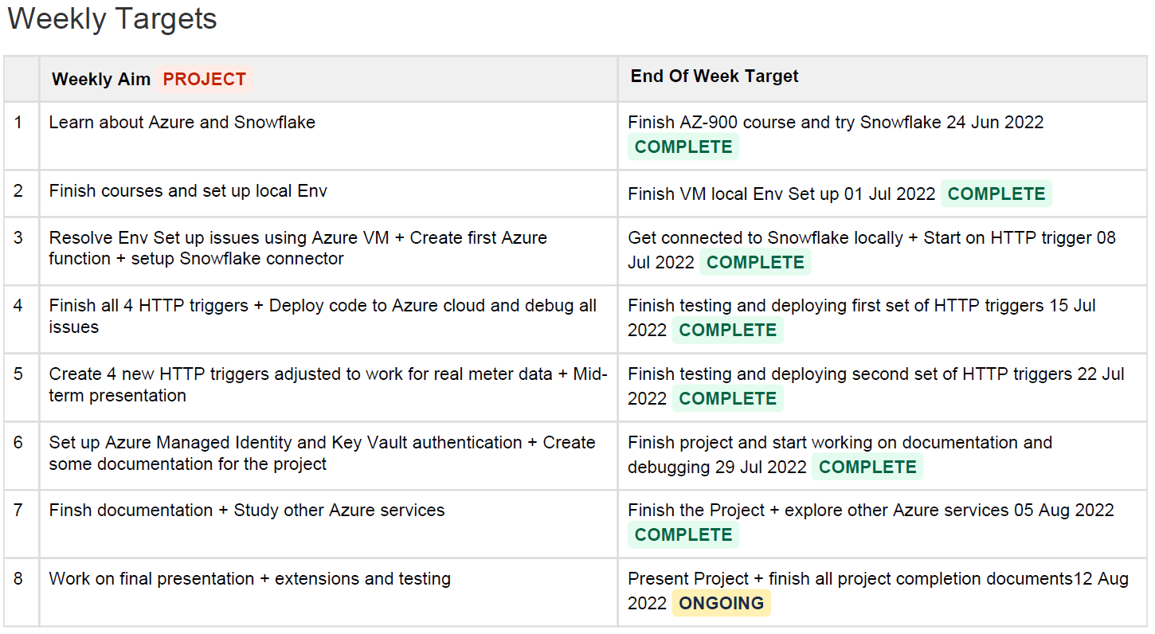
Weekly Plan

Slide 10
Real Meter Data Demo with all Triggers

Slide 11
Brief Look at the Python Solution

Slide 12
Documentation of the Scenario Testing and Error Handling
Link to documentation: https://gavinaren.atlassian.net/wiki/spaces/IP/pages/2228225/Scenario+Testing

Slide 13
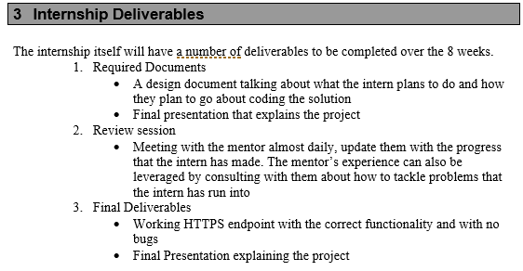
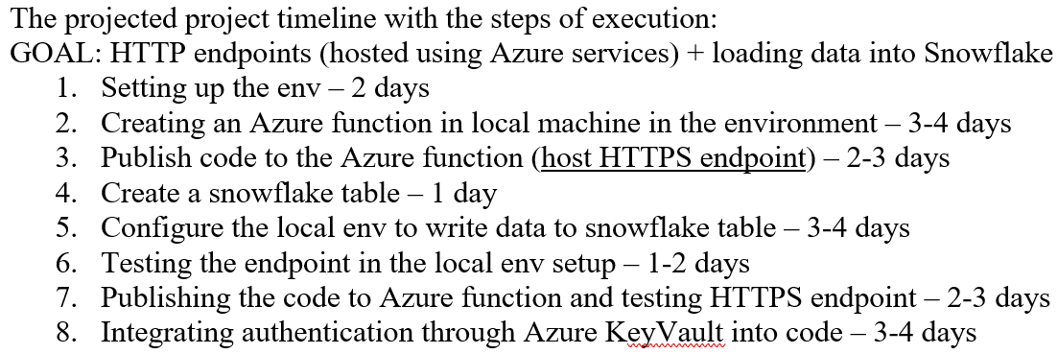

Final Reflection on Workflow doc
Notes:
I was able to complete all parts of the project and deliver on time the correct deliverables

Slide 14

Things I have learnt
Programmers must familiarise themselves with using documentation
Professionals must operate with responsibility and set their own deadlines and reflect on it
It is a part of the job to know how to resolve your own technical issues and raise tickets etc.
Enjoyed solving problems on my own, gained confidence, sometimes got a new perspective from Anji on various issues
Exec Lounge talks have been absolutely excellent
Notes:
1)Few times in the project I’ve spent a day just reading lots of documentation and understanding a new software/platform
5) Sanjay Shahay (Digital Marketing)- Everyone has a lot of ideas, but people who are able to execute it and scale it, are going be successful. Ideation is easy, persistence is more important.

Slide 15

Closing thoughts..
I have thoroughly enjoyed working on this project and getting a glimpse of what every-day work might be like in the industry.
I would like to thank all the employees involved with InStep and Infosys for granting me this opportunity and I look forward to applying to work at Infosys after I graduate.

